Slide 1
VLSI System Design Project
Face Detection Accelerator
Taiwan No.1
沈育同、施鈞陽、謝炎璋、林佑恩、王得祐、温偉程

Slide 2
Outline
Introduction
Method
Architecture
Timing Analysis

Slide 3
Outline
Introduction
Method
Architecture
Timing Analysis

Slide 4

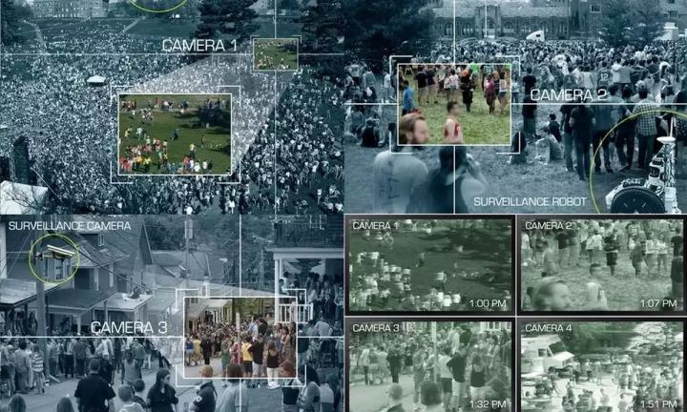
Introduction
Face recognition application
Photo Auto-Tagging (Facebook)
天網 (China)

Slide 5
Introduction
How to detect faces ?

Slide 6
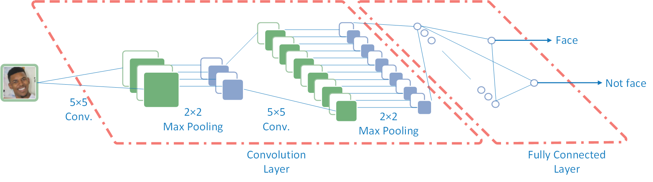
Introduction
How to detect faces ?

Slide 7
Introduction
Convolution
Kernel
Output
Input

Slide 8
Introduction
Pooling
maximum
Output
Input

Slide 9
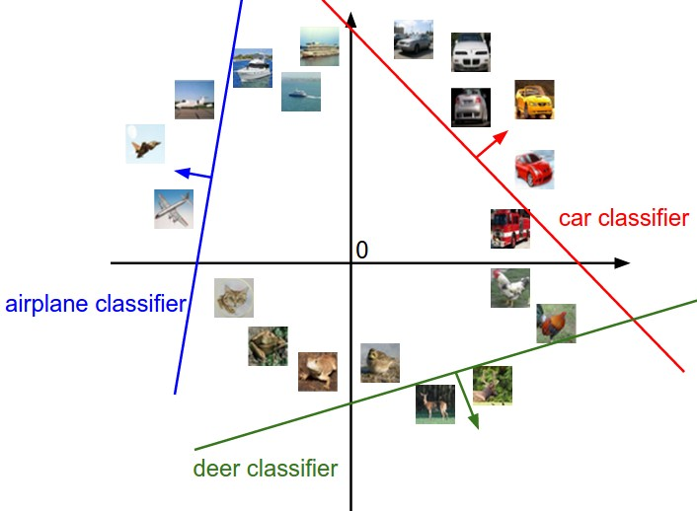
Introduction
Classification

Slide 10
Outline
Introduction
Method
Architecture
Timing Analysis

Slide 11

Method
Data Set : LFW

Slide 12
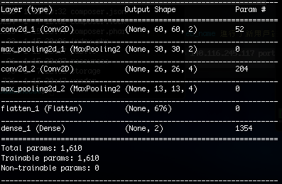
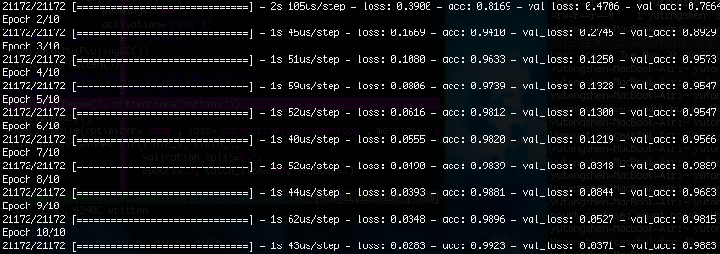
Method
Using Keras to train module

Slide 13

Method
Inference
Convolution
Shape = (17, 24, 2)
Shape = (298, 398, 2)
Shape = (147, 197, 4)
Shape = (600, 800, 1)

Slide 14
Outline
Introduction
Method
Architecture
Timing Analysis

Slide 15
Architecture

Slide 16
Architecture - CPU

Slide 17
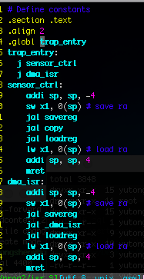
Architecture - CPU
Interrupt
Interrupt

Slide 18
Architecture - DMA

Slide 19
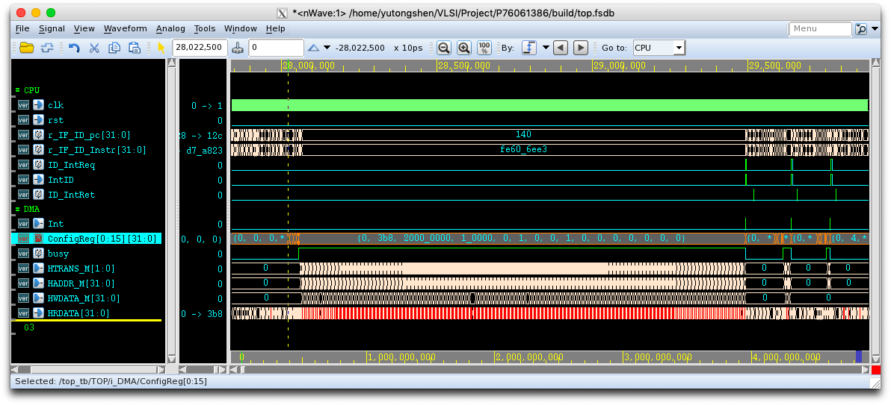
Architecture - DMA

Slide 20
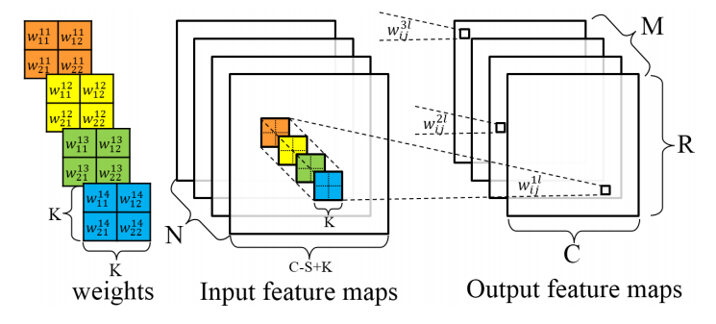
Architecture – Convolution Accelerator
Convolution computing
ref: C. Zhang, P. Li, G. Sun, Y. Guan, B. Xiao, and J. Cong, “Optimizing fpga-based accelerator design for deep convolutional neural networks,” in FPGA, 2015.

Slide 21
Architecture – Convolution Accelerator

Slide 22
Architecture – Convolution Accelerator

Slide 23
Architecture – Convolution Accelerator

Slide 24
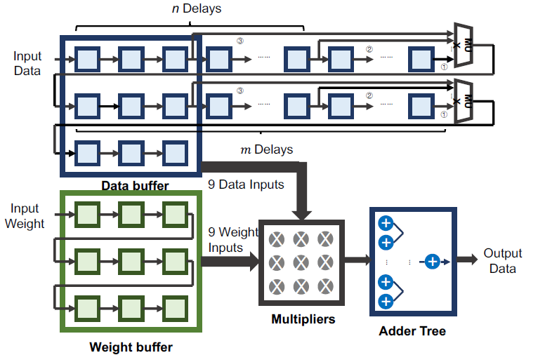
Architecture – Compare with others
ref: Jiantao Qiu, Jie Wang, Song Yao, Kaiyuan Guo, Boxun Li, Erjin Zhou, Jincheng Yu, Tianqi Tang, Ningyi Xu, Sen Song, Yu Wang, and Huazhong Yang. Going deeper with embedded fpga platform for convolutional neural network. In ACM International Symposium on FPGA, 2016

Slide 25
Architecture – Compare with others
Line buffer
Faster
1 data in 1 data out
More registers
800*4(kernel size -1) + 5
Ours
Less registers
5*5
Take more time
5 data in 1 data out

Slide 26
Architecture – Convolution Accelerator
2 layers convolution
Input : 800*600*1
Layer 1 output : 398*298*2 (16 bits)
Output : 197*147*4 (16 bits)
Cycles estimation
with output 3rd dimension parallel, Parallelism = 2
L1：800*600 (all input) + computing and pooling + 398*298*2 (all output) ≒ 1700000
L2： 398*298*2(last input) + computing and pooling + 197*147*4 (all output) ≒ 1250000
Overall： 1700000 + 1250000 ≒ 3000000(cycles)
Overall with control signal： 3000000 ~ 3700000(cycles)

Slide 27
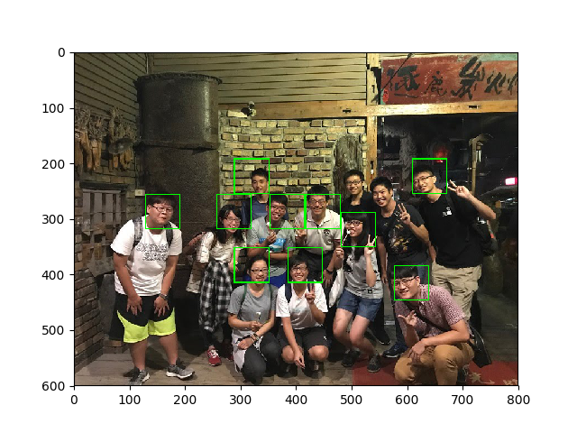
Architecture - Verification
Model training by Keras (floating point 32 bits)

Slide 28

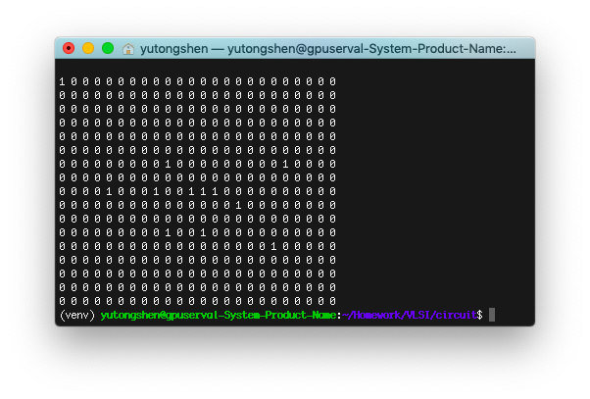
Architecture - Verification
Convert weights to 16 bits fixed point

Slide 29
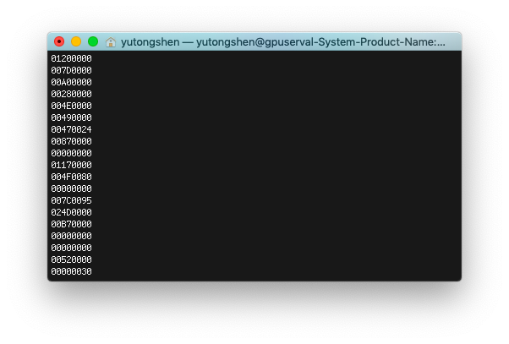
Architecture - Verification
Generating ground true
Cut

Slide 30
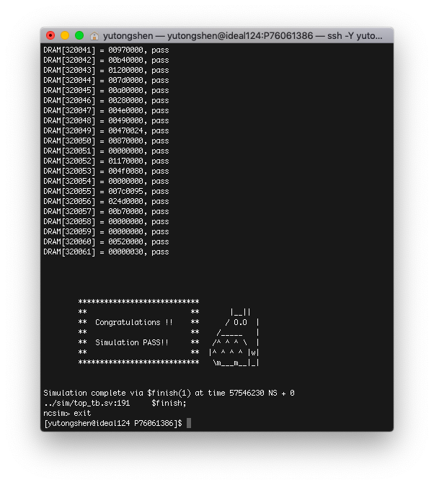
Architecture - Verification
Result

Slide 31
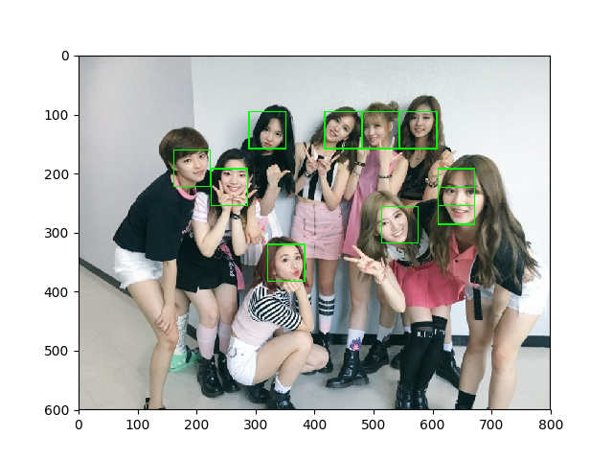

Architecture - Verification
Floating point 32 bits v.s. fixed point 16 bits

Slide 32
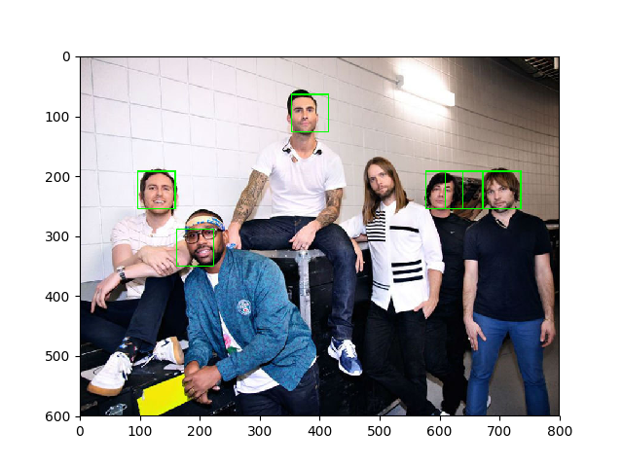

Architecture - Verification
Floating point 32 bits v.s. fixed point 16 bits

Slide 33
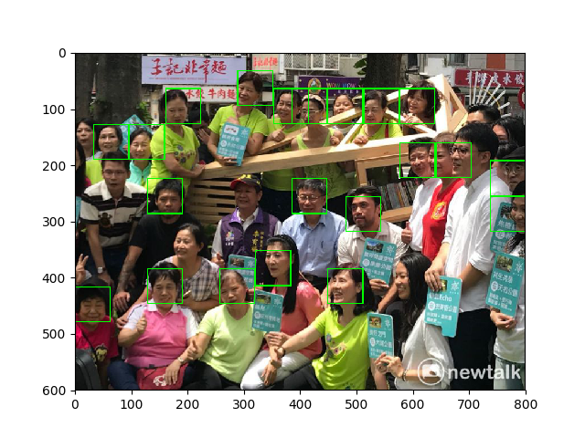
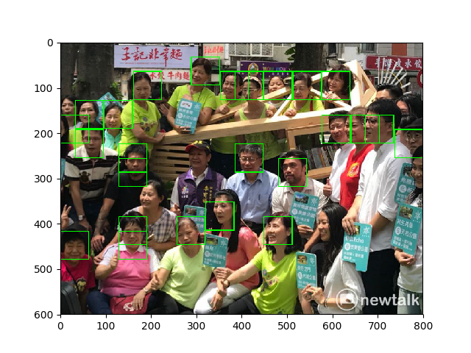
Architecture - Verification
Floating point 32 bits v.s. fixed point 16 bits

Slide 34
Outline
Introduction
Method
Architecture
Timing Analysis

Slide 35
Timing Analysis
Cutting 4 segments

Slide 36
Timing Analysis
Cutting 4 segments

Slide 37
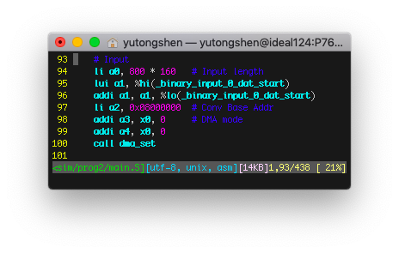
Timing Analysis
Step 1. Move the segment of input from external DRAM to ASPU memory

Slide 38
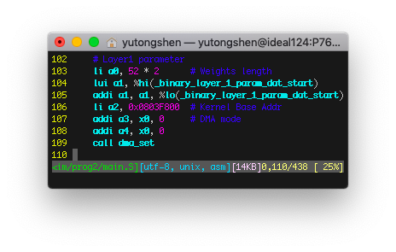
Timing Analysis
Step 2. Move convolutional weights (layer1) from external DRAM to ASPU memory

Slide 39
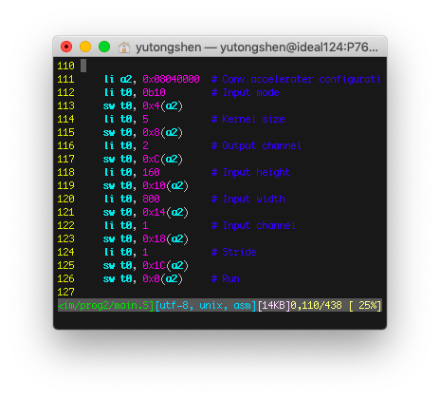
Timing Analysis
Step 3. Setting convolutional accelerator

Slide 40
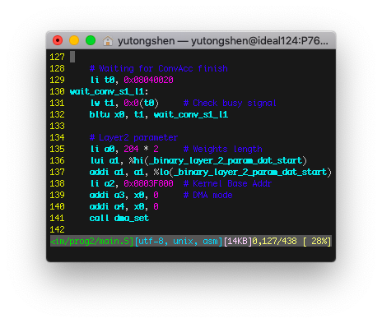
Timing Analysis
Step 4. Waiting for Convolutional accelerator finish, then move convolutional weights (layer2) from external DRAM to ASPU memory

Slide 41
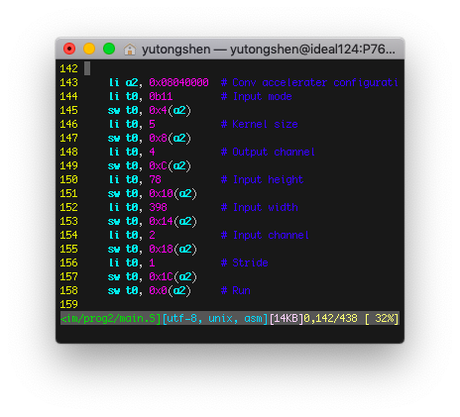
Timing Analysis
Step 5. Setting convolutional accelerator

Slide 42
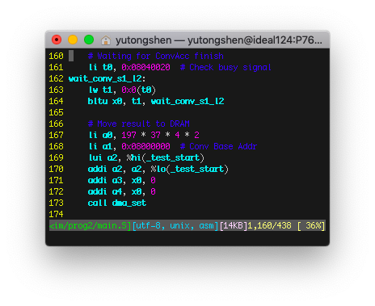
Timing Analysis
Step 6. Moving result to DRAM

Slide 43
Timing Analysis

Slide 44
Timing Analysis

Slide 45
Thanks for listening

